Slide 1
CharRNN Text Generator: Exploring Language Modeling with PyTorch
Presented By:
Yuvan Velkumar S,
KGiSL Institute Of Technology,
NM ID:au711721243127

Slide 2

AGENDA
Problem Statement
Project Overview
Who are the end users?
Solution and its value proposition
Modelling
Results
Conclusion
References

Slide 3

PROBLEM STATEMENT
Given a sequence of words, the computer tries to predict what the next word will be.
It's like teaching a computer to understand and generate human-like language.
This can be useful in many applications, like autocomplete suggestions, speech recognition, or even generating realistic text for chatbots or virtual assistants.

Slide 4

PROJECT OVERVIEW
The objective of this project is to develop a simple text generation model using a recurrent neural network (RNN) implemented in PyTorch. The model is trained on a small corpus of text data and then used to generate new text based on a given input prompt.
Project Components:
Data Preprocessing:The provided code preprocesses the input text data by tokenizing it into characters and converting them into numerical representations using one-hot encoding.
Model Architecture:the model architecture consists of a single-layer RNN followed by a fully connected layer.The RNN processes the input sequences and learns to predict the next character in the sequence.The fully connected layer maps the RNN output to the vocabulary size for character prediction.
Training:The model is trained using the provided training loop.It uses the Adam optimizer and CrossEntropyLoss as the loss function.The training loop runs for a specified number of epochs, updating the model parameters to minimize the loss.
Text Generation:Two functions, predict and sample, are provided for generating text.The predict function predicts the next character given a sequence of characters.The sample function generates a sequence of text starting from a given prompt using the predict function.
Usage:After training the model, the sample function can be used to generate text based on user-provided prompts.

Slide 5

WHO ARE THE END USERS?
Content Creators:Writers, bloggers, journalists, and other content creators might use the text generation model to generate ideas, brainstorm content, or overcome writer's block by providing prompts and letting the model generate potential storylines, article drafts, or creative passages.
Language Learners:Language learners could benefit from using the text generation model to generate example sentences or paragraphs based on specific grammar rules or vocabulary they are studying. The model could help them practice reading comprehension, grammar, and vocabulary acquisition in a contextualized manner.
Chatbot Developers:Developers of chatbots and virtual assistants might employ text generation models to enhance the conversational abilities of their bots. By integrating the model, chatbots can generate more human-like responses, engage users in longer conversations, and provide more personalized interactions.
Creative Writing Enthusiasts:Amateur writers, poets, and storytellers may find the text generation model useful for inspiration and exploration of new writing styles. They can use the model to generate starting points, plot twists, character descriptions, or dialogue snippets to kickstart their creative process.
Educational Institutions:Teachers and educators could utilize the text generation model as a teaching aid in language arts, creative writing, or computational linguistics courses. Students can interact with the model to learn about language structure, grammar rules, and creative expression.

Slide 6
SOLUTION AND ITS VALUE PROPOSITION
Data Preprocessing:Clean the text data by removing noise and tokenizing it into numerical representations.
Model Architecture:Choose an RNN architecture and define its parameters.
Initialization:Initialize the RNN model with random weights.
Training Loop:Iterate over the dataset for a specified number of epochs:Input sequences into the RNN model.Compute and minimize the loss using an optimization algorithm.
Evaluation:Periodically evaluate the model's performance using validation data.
Hyperparameter Tuning:Experiment with different hyperparameters to optimize performance.
Testing:Evaluate the final trained model on a test dataset to assess its performance.
Deployment:Deploy the trained model for inference in applications or services.

Slide 7
SOLUTION AND ITS VALUE PROPOSITION
The value proposition of the outlined approach for language modeling is as follows:
Efficient Data Preprocessing: By cleaning the text data and tokenizing it into numerical representations, the preprocessing step ensures that the model receives clean and standardized input. This improves the model's ability to learn meaningful patterns and relationships in the data.
RNN Architecture Selection: Choosing an RNN architecture allows the model to capture sequential dependencies within the text data effectively. RNNs are well-suited for sequential data processing tasks like language modeling, making them a suitable choice for this application.
Initialization with Random Weights: Initializing the RNN model with random weights enables it to start learning from scratch. This allows the model to adapt and adjust its parameters during the training process, gradually improving its performance over time.
Training Loop and Optimization: The training loop involves iteratively feeding input sequences into the RNN model and optimizing its parameters to minimize the loss function using an optimization algorithm. This process enables the model to learn from the data and improve its predictive accuracy.

Slide 8
THE WOW IN SOLUTION
The issue statement's broad application and the difficulties in creating solutions that can precisely predict human language are what make it special. The following features draw attention to how special the problem is:
Complexity of Human Language: Due to subtle differences in grammar, syntax, semantics, and context, human language is extremely complicated. It is a unique problem in the field of artificial intelligence to teach a computer to comprehend and produce language that is similar to that of a human.
Contextual Understanding: Language prediction calls for a thorough comprehension of context, in contrast to conventional pattern recognition tasks. The words that come before it in a series frequently influence the word that comes after it as well as the larger context of the dialogue or document. This calls for the creation of models that can accurately collect and utilize context.

Slide 9
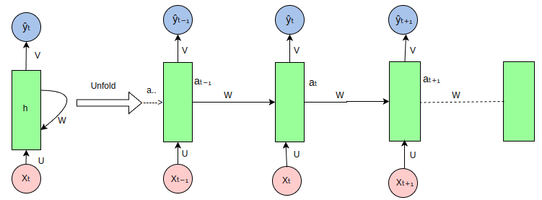
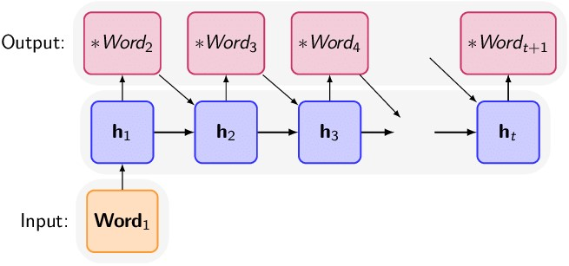
MODELLING
The RNN takes an input vector X and the network generates an output vector y by scanning the data sequentially from left to right, with each time step updating the hidden state and producing an output. It shares the same parameters across all time steps. This means that, the same set of parameters, represented by U, V, W is used consistently throughout the network. U represents the weight parameter governing the connection from input layer X to the hidden layer h , W represents the weight associated with the connection between hidden layers, and V for the connection from hidden layer h to output layer y. This sharing of parameters allows the RNN to effectively capture temporal dependencies and process sequential data more efficiently by retaining the information from previous input in its current hidden state.

Slide 10
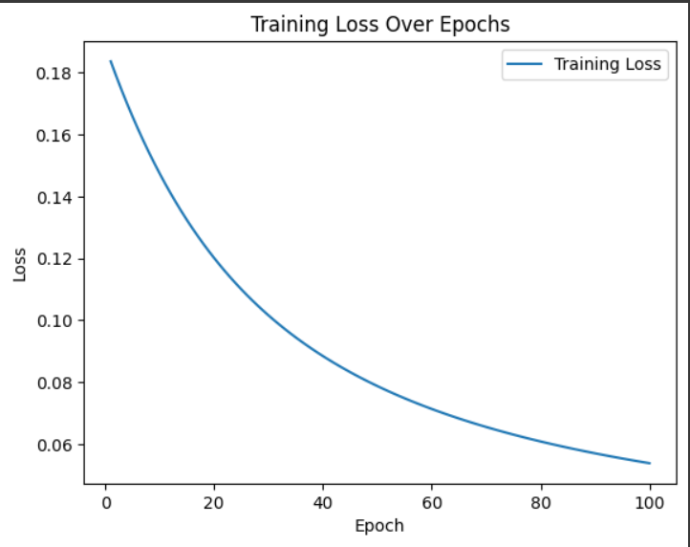
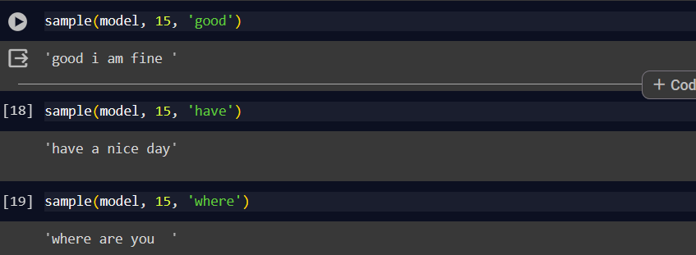

RESULTS

Slide 11
CONCLUSION
In conclusion, the difficulty of teaching a computer to produce language that is human-like and predict the next word in a sequence is distinct and complex, having wide-ranging applications in a variety of fields. Dealing with the complexities of human language, including subtleties in syntax, semantics, grammar, and context, is part of this work. Furthermore, it calls for the creation of models that can successfully manage the ambiguity and uncertainty inherent in language, comprehend and use context, and engage with users in real time. Furthermore, in order to guarantee inclusion and equity, language prediction systems need to be flexible enough to accommodate different user preferences and writing styles while taking ethical and sociocultural issues into account.

Slide 12
REFERENCES
Cho, K., Van Merriënboer, B., Gulcehre, C., Bahdanau, D., Bougares, F., Schwenk, H., & Bengio, Y. (2014). Learning Phrase Representations using RNN Encoder-Decoder for Statistical Machine Translation. arXiv preprint arXiv:1406.1078.
Karpathy, A. (2015). The Unreasonable Effectiveness of Recurrent Neural Networks. Blog post. Available online: http://karpathy.github.io/2015/05/21/rnn-effectiveness/.
Graves, A. (2013). Generating Sequences with Recurrent Neural Networks. arXiv preprint arXiv:1308.0850.
Goodfellow, I., Bengio, Y., Courville, A., & Bengio, Y. (2016). Deep Learning. MIT Press.
Brownlee, J. (2019). Deep Learning for Natural Language Processing: Develop Deep Learning Models for Natural Language in Python. Machine Learning Mastery.
PyTorch Documentation: https://pytorch.org/docs/stable/index.html
TensorFlow Documentation: https://www.tensorflow.org/api_docs

